Slide 1


FINAL YEAR PROJECT PRESENTATION ON “ZERO INTRUSION SMART PORTABLE SWITCH”
UNIVERSITY OF MUMBAI

Slide 2


ZERO INTRUSION SMART PORTABLE SWITCH
PRESENTED BY :
VED V. AHINAVE (ROLL NO - 02)
KOMAL T. NAIK (ROLL NO - 08)
PRESENTED TO :
FINAL YEAR PROJECT
COMMITTEE DEPARTMENT OF
INFORMATION TECHNOLOGY
(BSc.IT DEPT 2020)
GUIDE :
PROF. RAJESH MAISALGE
PROF. DIVYA BOHRA
PROF. SHWETA KUMAR
(HOD)
PROF. RAJESH MAISALGE
NIRANJANA MAJITHIA COLLEGE OF COMMERCE
(2018-2020)

Slide 3
PROBLEM STATEMENT
The idea behind IoT is to create a system that stores all data required by human beings without having a direct hand in collecting it. Research suggests that the impact of IoT on the world will be monumental in upcoming years.
The first smart homes were ideas, not actual structures. For decades, science fiction has explored the idea of home automation.
Many IoT Systems are poorly designed and implemented, using diverse protocols and technologies that create complex configurations. Lack of mature IoT technologies and business processes. Limited guidance for life cycle maintenance and management of IoT devices. Limited best practices available for IoT developers.

Slide 4
PURPOSE AND SCOPE
Home Automation using IOT and Arduino. The main objective of this project is to build a smart home device which can be used to control the home appliances via internet. ... This establishes the internet connection to the system and all the home appliances can in turn be connected and controlled by internet.
This is a simple servo mount that you can attach to a standard switch plate.
Future scope for the home automation systems involves making homes even smarter. Homes can be interfaced with sensors including motion sensors, light sensors and temperature sensors and provide automated toggling of devices based on conditions.

Slide 5
OBJECTIVES
This Instructable is all about one of life's simple actions, flipping a light switch on and off. As we do it many times a day, so many in fact it came to a point where we asked ourselves "Can't we get an Arduino to do this?". Of course we can, what follows is how we went about doing it. With the help of some acrylic, nuts and bolts and a small hobby servo we have made a great little switcher (we're calling it our Servo Switcher - (SESW)).

Slide 6
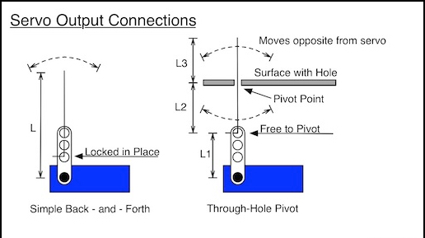
SYSTEM ARCHITECTURE
MATERIALS USED FOR FINAL INVENTION BUILT :
AURDINO UNO
SERVO MOTOR SG90
BREADBOARD AND JUMPER WIRES
BLUETOOTH MODULE HC-05
POWER SUPPLY (BATTERY)
CIRCUIT BOX FOR INTEGRATION

Slide 7

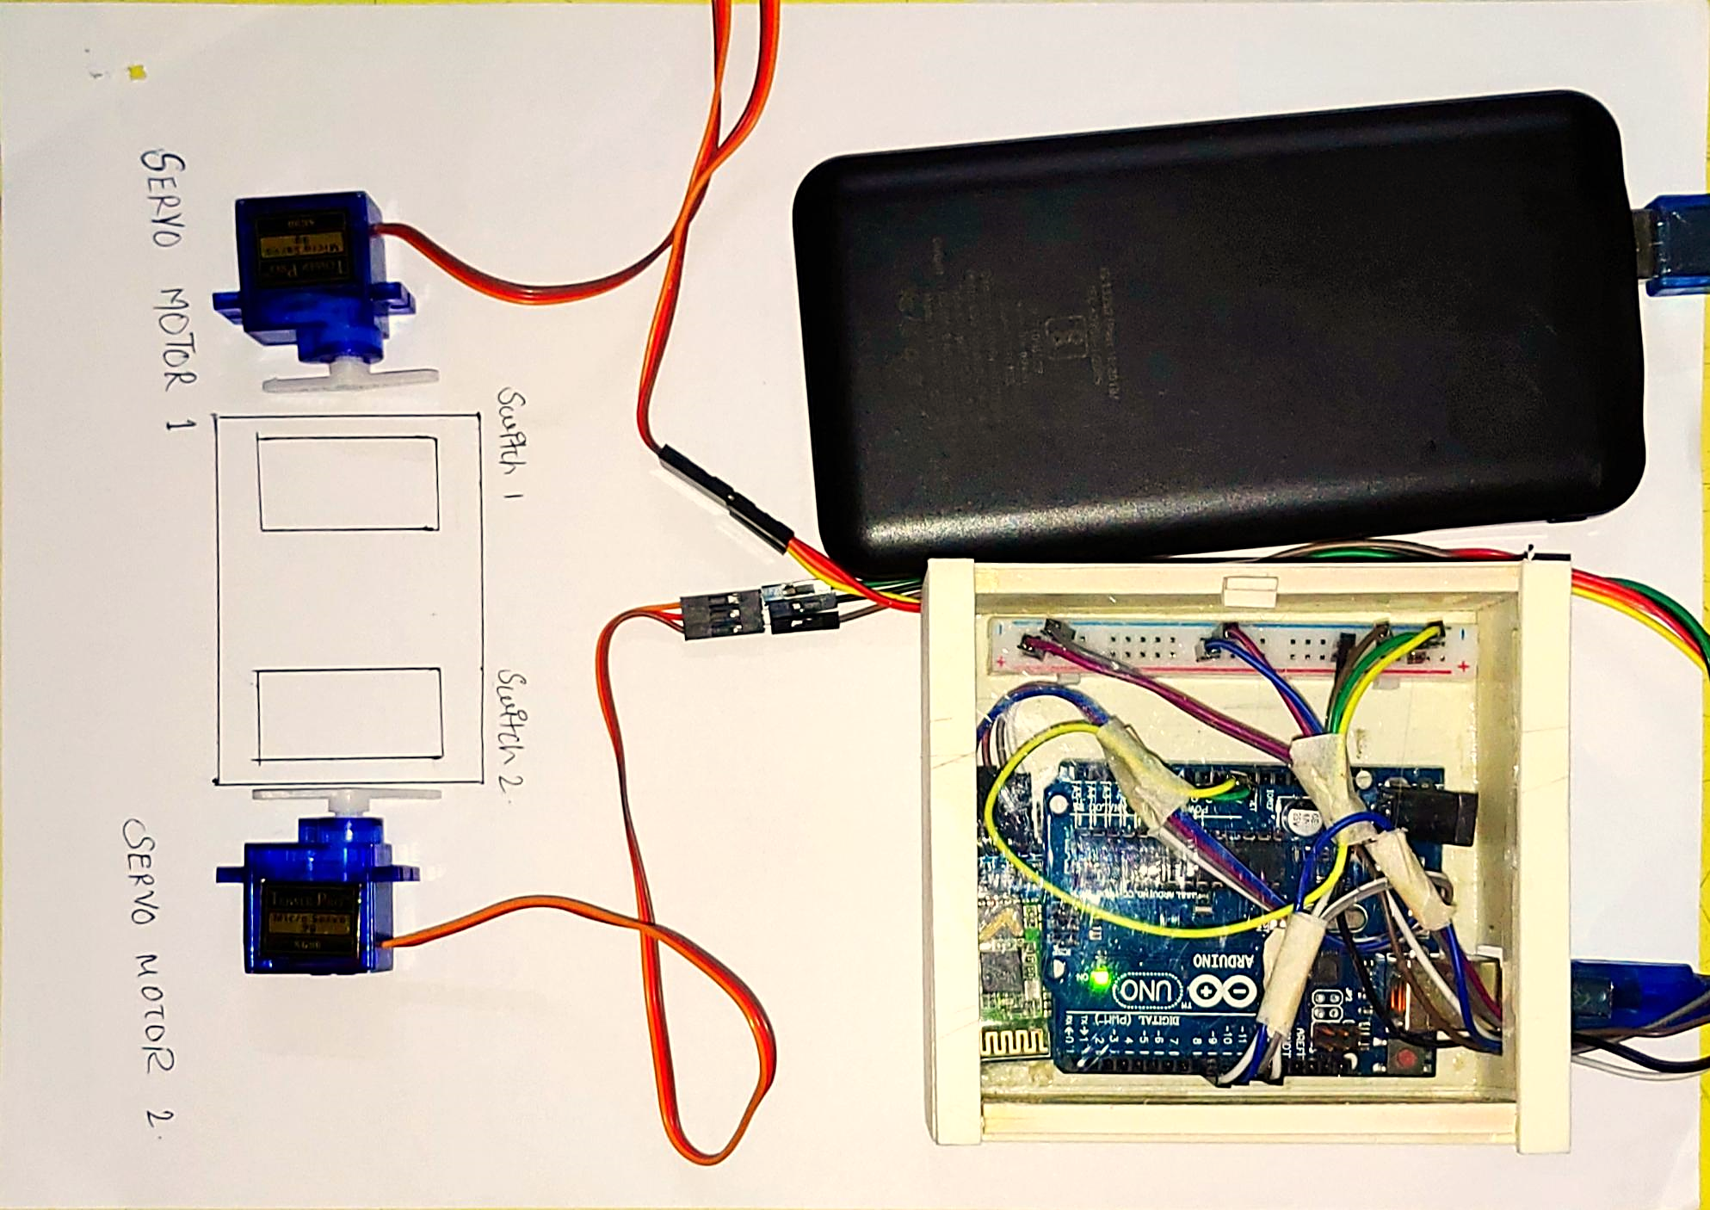
HARDWARE
MALE/FEMALE CONNECTORS AND BREADBOARD
POWER SUPPLY
SERVO MOTORS
(SG90)
CIRCUIT BOX MADE
FROM ACRYLIC
BLUETOOTH MODULE
HC-05
AURDINO UNO

Slide 8

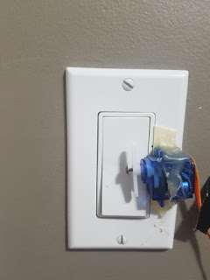
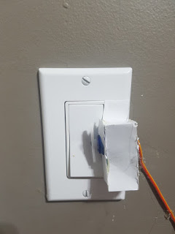
WORKING
KEY FEATURES :
No need to mess with any high voltage wiring.
Switch is still Operable by hand.
Easy to make and Assemble.
High Mobility.

Slide 9
CONCLUSION
IoT is trending. Companies invest in new tech to streamline business processes and cut expenses. Consumers buy wearables and Smart Home appliances to save time and improve the quality of their lives. If you’re set on releasing a smart device or consider optimizing your business workflow with the Internet of Things solutions, you need to get an idea of how much it may cost you to build one. In this article we’ll try to figure out what may constitute the final cost of an IoT solution
INTERNET OF THINGS COST BREAKDOWN
The Internet of Things is the environment where gadgets equipped with smart sensors collect data and exchange it over a network.
Thus, the system operates on three levels:
Hardware (various objects enhanced with firmware/embedded systems and smart sensors).
Infrastructure (a piece of software that receives, analyzes and stores sensor data; it runs in the cloud or on a corporate server).

Slide 10


THANK YOU FOR WATCHING
REGARDS VED AHINAVE & KOMAL NAIK

